Slide 1
Instructions for
Accounting Analytics

Slide 2
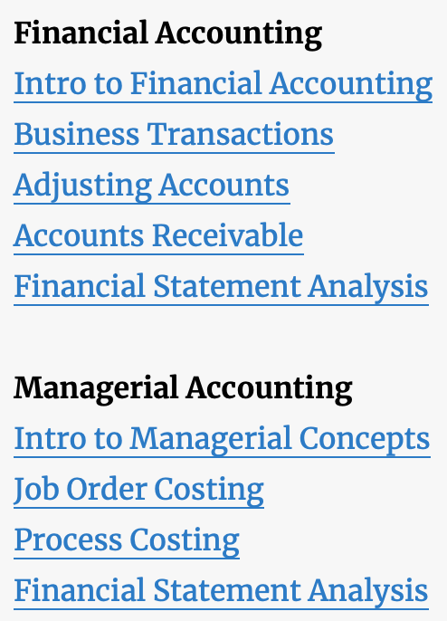
Select the Topic
Select 1 of the 9 topics assigned by your instructor.
In this case, assume we are assigned “Accounts Receivable.”

Slide 3
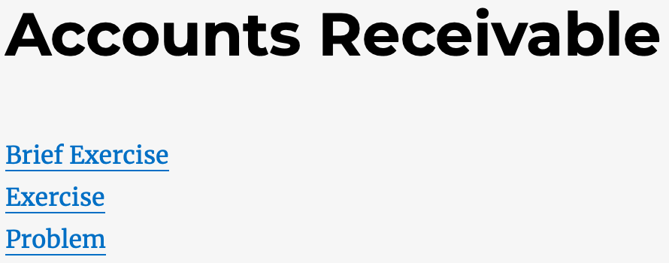
Select the Assignment
Select the assignment indicated by your instructor.
In this case, assume we are assigned an “Exercise.”

Slide 4
Use Tableau Tooltip
Use the Tableau Tooltip to extract information. Simply hovering your cursor above different graphics will cause the tooltip to pop up.

Slide 5
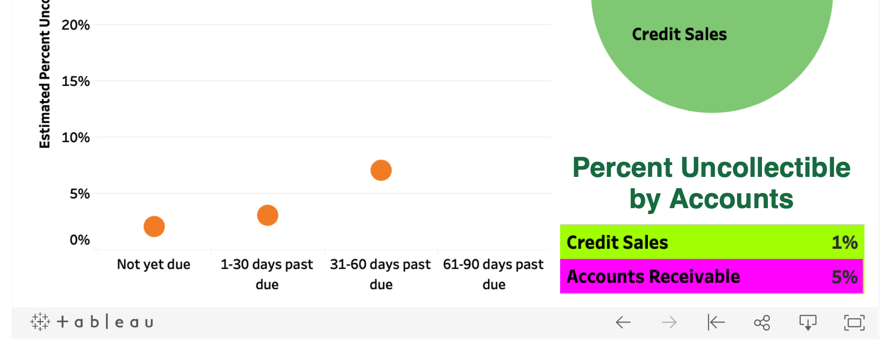
Other Functions
Students do not need to modify the dashboard to answer assignments.
If the Dashboard is accidently modified, click the Reset button to restore the original Dashboard.
No other button on the bottom bar of the Dashboard is used.

